Slide 1
A Central Australian Aboriginal Community Perspective. Tracey Brand General Manager, Health Services Central Australian Aboriginal Congress
Ice and Central Australia: From Research to Practice
A Central Australian Aboriginal Community Perspective. Tracey Brand, General Manager, Health Services
Notes:
I would like to begin by acknowledging the Arrernte people, my elders past and present who are the traditional owners of Mparntwe land on which we are meeting today. I would also like to thank CAYLUS for inviting me to share with you today the role that an Aboriginal community controlled comprehensive primary health care service is responding in the prevalence in ICE.

Slide 2
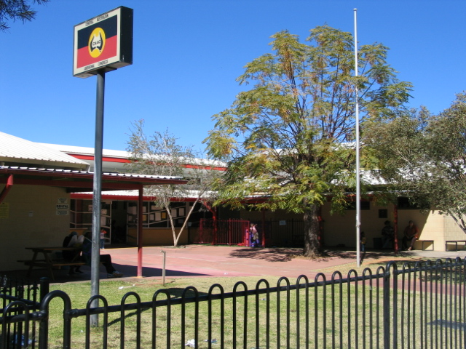
Notes:
The Central Australian Aboriginal Congress is an Aboriginal community controlled medical service.
In the 40 years since Congress was established, we have become the largest Aboriginal community controlled primary health care service in the Northern Territory. Since 1973 Congress has continued to promote a broad approach to improving Aboriginal health and Closing the Gap on Aboriginal life expectancy.
As the 1989 National Aboriginal Health Strategy stated: 'Health to Aboriginal peoples is a matter of determining all aspects of their life, including control over their physical environment, of dignity, of community self-esteem, and of justice. It is not merely a matter of the provision of doctors, hospitals, medicines or the absence of disease and incapacity.' (National Aboriginal Health Strategy Working Party, 1989)

Slide 3
Notes:
Today, we are one of the most experienced organisations in the country in Aboriginal health, a national leader in comprehensive primary health care, and a strong political advocate for the health of our people.
Congress has a skill based board including six (6) member elected directors and three (3) independent non-member directors. Independent non-member directors provide a strong balance to Congress governance and strategic positioning providing expert advice on finance, governance and administration and primary health care.
Congress has four divisions each reporting to our CEO Donna Ah Chee. Health Services, Public Health, Business Services and Human Resources.
Congress is one of the largest employers in Central Australia employing over 300 people across our clinical, social support and administrative services. Congress has a large multi disciplinary clinical team employing 19 GPs, a teams of AHP, RN, Midwifes, Psychologists, Social Workers, Podiatrist, Dieticians, Nutritionist, Pharmacist, Dentist, a team of Aboriginal Care Coordinators, Aboriginal Liaison Officers, Aboriginal Community Support Workers, Early Childhood Educators, Youth Workers and transport officers. Our service delivery is supported by a strong compliment of administrative support services.

Slide 4
Aboriginal Resident Client Population
across all Congress Clinics
Clinic | Resident Population as at 30 June 2015
Congress Town Clinics | 9462
Ntaria | 702
Santa Teresa | 593
Mutitjulu | 479
Amoonguna | 431
Utju | 167
Wallace Rockhole | 76
Notes:
Congress also delivers health services in partnership with five remote communities . Congress town and remote services has a combined unique client base of just under 12,000 clients.

Slide 5
Notes:
This graphs highlights Congress episodes of care over time.
Over this period, the remote clinic have maintained a relatively stable trend with few peaks and troughs, while the number of episodes of care provided by Congress town services have almost doubled. This may be partly attributed to the growth of services in the Social Emotional Wellbeing Program.

Slide 6
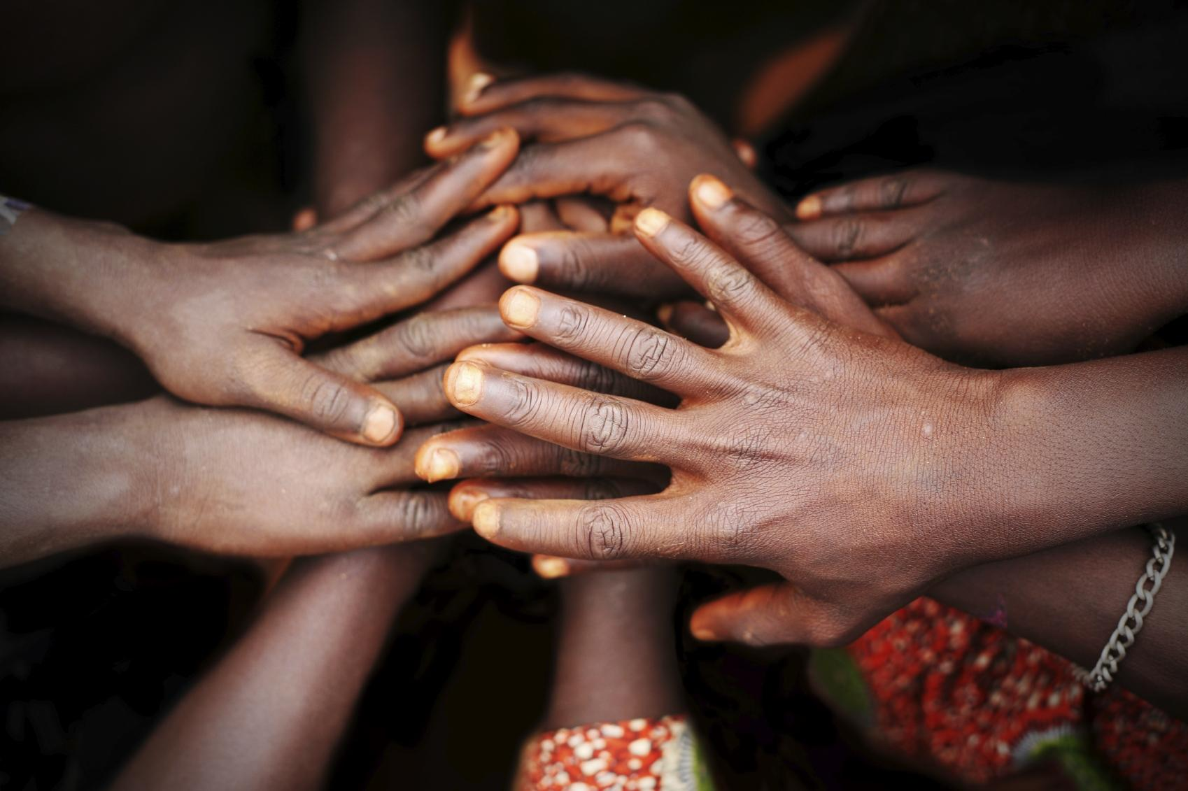
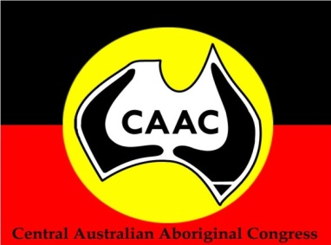
Towards an evidence based alcohol and other drug treatment model
Notes:
Under the Health Services Division, the Social and Emotional Wellbeing section has been delivering an Alcohol and Other drug treatment program for over six years. We work in a holistic and culturally appropriate way and aim to facilitate improved wellbeing for Aboriginal people experiencing the effects of harmful alcohol and drug use.
Evaluation and evidence based research continues to inform our practices.
Congress currently employs five local Aboriginal AOD Care Coordination workers in Alice Springs and local AOD workers in Ntaria, Santa Teresa and Mutitjulu.
Over 500 clients are actively engaged with Congress AOD treatment programs.

Slide 7
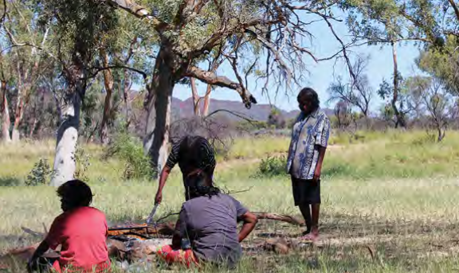
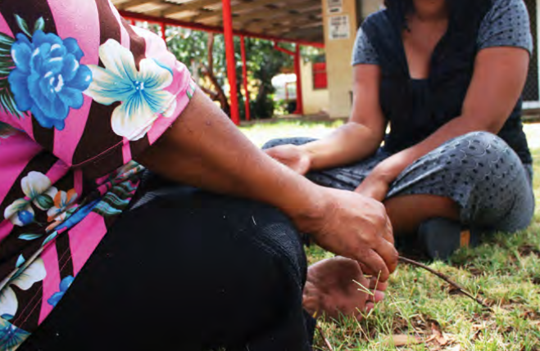
Notes:
There are many soft access points within Congress for Aboriginal clients to be referred to Congress treatment services including our main clinic, Ingkintja Men’s health clinic, Alukura women’s health clinic, our remote clinics and for young people, Headspace that Congress is the proud lead agency for. Congress also receives self referrals and referrals from external providers.
Our treatment service includes a GP, a team of therapists including three clinical psychologists and a team of AOD care coordination workers.
working in a holistic and culturally appropriate way the Congress AOD treatment program aims to facilitate improved wellbeing for Aboriginal people experiencing the effects of harmful alcohol use.

Slide 8
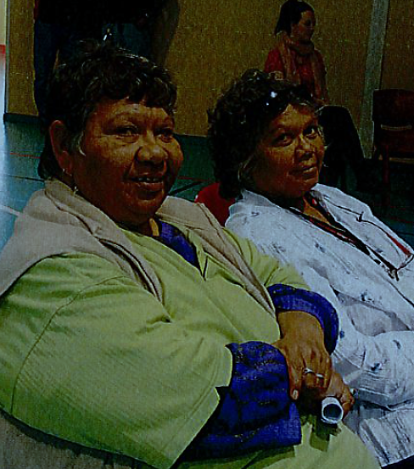
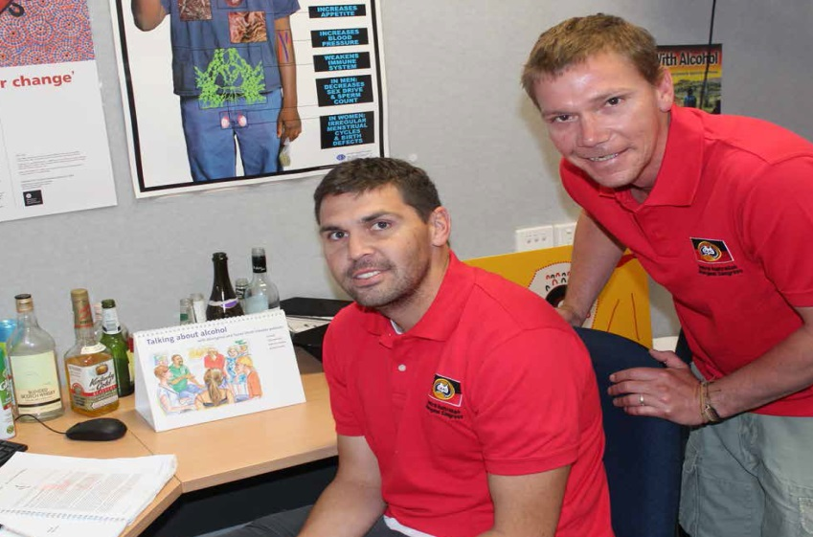
Notes:
These are some of our AOD Care Coordination Workers that offers a range of service to clients including - men’s and women's bush trips, Art as therapy, Connect clients back to country, provide support with everyday needs, Health checks, Psycho-education about the effects of alcohol and Counselling

Slide 9
Drug addiction is a
BRAIN disease that is expressed in BEHAVIORAL ways and which occurs in a
SOCIAL context
Notes:
This new understanding of addiction has paved the way for Congress’ treatment approaches that addresses each of the 3 areas that are involved in the development and maintenance of addictions. My Colleage, Dr John Boffa will talk more on these in his presentation later this morning.

Slide 10
Service delivery model: 3-stream approach with care coordination and case management
Psychosocial
Stream
Medical
Stream
Social and
cultural support
Notes:
Congress adopts a three stream of care approach.
Treatment services need to provide social and cultural support to be able to help the client change the social context which is part of the reason that addiction occurs and is maintained.
The medical stream uses medicines that specifically address the biological changes that occur in the brain and effect the balance of chemicals in the brain that affect the way the reward centre in the brain works.
Finally, the psycho-social stream addresses the behavioral expression of addiction and changing behaviours can in and of itself help to reset the abnormal neural pathways that reinforce and perpetuate the addiction.

Slide 11
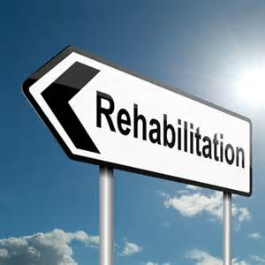
Notes:
Congress partner and compliment a number of AOD services in Alice Springs.
Of particular note is Congress partnership with the Drug and Alcohol Service Association of Alice Springs (DASA) to ensure good access to the three streams of care within a residential treatment facility for all drugs. For any person who is dependant on a particular drug a period of total abstinence in a residential facility is often but not always a great way to commence treatment.
In partnership with DASA, Congress has been able to successfully rehabilitate Aboriginal people with alcohol ICE and other drug dependencies. We provide the initial medical assessment, mental health care plan including a sickness certificate and any required medications as well as structured psycho-therapy thru visiting psychologist funded through Medicare. DASA provide the supported accommodation and onsite counselling and social and cultural support. On discharge clients can maintain their continuity of care with a known GP and a known psychologist along with other supports from DASA. This is a really effective treatment model and we encourage anyone with a problem with ICE or other drugs to seek treatment which is proving to be very effective.

Slide 12
Notes:
There is a lot of concern in our community on the prevalence of ICE. There isn’t too many Aboriginal people in our community that hasn’t been effected by a family member or friend that has been on ICE. I have also been one of those, with my own son who also experienced an addiction with ICE.
As a Aboriginal community controlled organisation, Congress responded to the needs of our community and commenced an ICE support group. We were guided by our sister organisation in Darwin Danila Dilba who had been running their own community support group.
Congress also invested in our AOD workers engaging the services of Caraniche a Victorian-based leader in ICE treatment services to better inform and upskill our workforce in ICE treatments.
Our first Community gathering was held on 12 May and attracted over fifty people; a mix of providers and community members. The first meeting was co-chaired by the Chair of the Danila Dilba community group and one of our own AOD workers, Aunty Dorrie Wesley. Meetings are now closed to community members. Attendance fluctuates.

Slide 13
Notes:
Support groups continued to be held on the second Tuesday of each month with the next meeting held next Tuesday. Group meetings are chaired by one of our Aboriginal AOD care coordination workers and a Therapist is always on hand.
The Group attracts a mix of Aboriginal and non Aboriginal community members and provide a confidential and safe environment for community members to share their experience, to be informed on ICE, learn coping strategies including brief interventions, feel more empowered and to know they are not alone. Through the groups, members are enabling a shared awareness of the drug ICE, the effects, access to services, coping strategies and peer support.
The community guide the meeting and invite relevant stakeholders. A recent meeting invited the Police and ADSCA.
The group spoke to the police on the need for anonymous reporting of dealers to the police and with ADSCA on assistance to families during a “crisis” incident of a user.
What we are finding is that many users are from supportive families.

Slide 14
Notes:
There is widespread concern in our community that there is an ICE epidemic in Alice Springs.
Members from our remote health boards have also raised concern on ICE having a presence in the community. Despite these reports from our remote sites, there is no evidence from Police or Community Night Patrols and no clients have yet presented to remote clinics with these effects.
While Congress offers are a number of entry points for Aboriginal people to seek medical interventions, we have seen less than 10 clients self present with ICE effects. For clients that do present, referrals are made to our Social and Emotional Wellbeing treatment services.
We know people who have an addiction are in denial and are less likely to connect to services, users may also be shame. As informed by our Community ICE group, there are three nets for users to be captured; through the Courts, Police and the Hospital. It is through this data and presentations to services that will better inform the true prevalence of this destructive drug.
Congress will continue to work with the community.

Slide 15
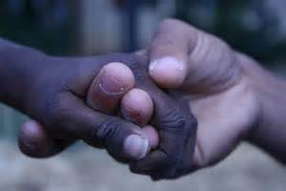
Notes:
ICE has no respect for colour, it is benefiting consuming but crippling families. As an Arrernte woman, I say ICE has no place in our community.
Thank you.

