Slide 1
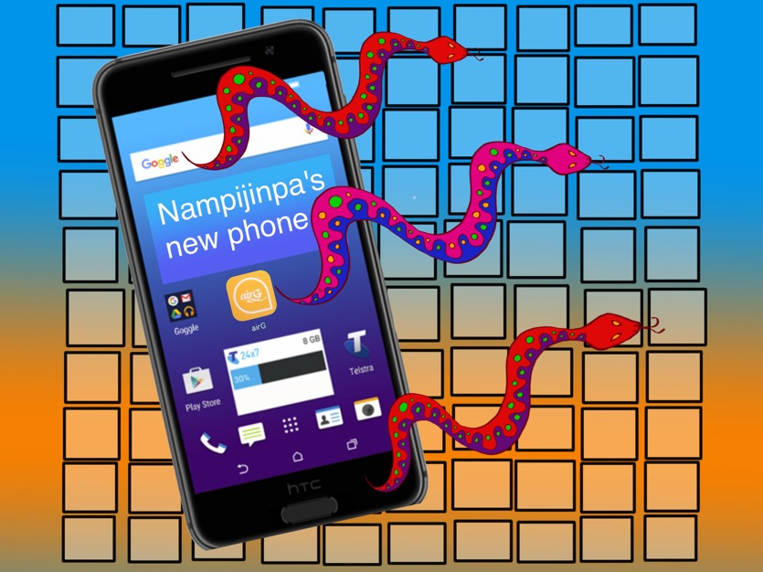
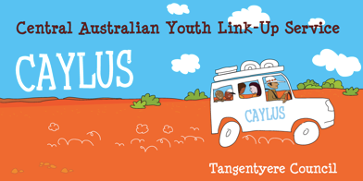
The life and times of a mobile phone out bush
Notes:
Hello, I am Jenny McFarland, and I work for Central Australian Youth Link Up Service (CAYLUS) in Alice Springs. This presentation is about some of the complex territory that has to be negotiated in the Aboriginal social and digital environment. I will be boring you with some stats first. The demographic and workforce participation stats are sourced from research using ABS stats. Then I will tell you some true stories from the bush.

Slide 2
For every 100 people in a remote aboriginal community
Notes:
These stats provide essential context for this presentation. For every 100 Aboriginal people living in a remote community...

Slide 3
Notes:
8 have a disability, not including those with under or undiagnosed disabilities such as FASD and autism.

Slide 4
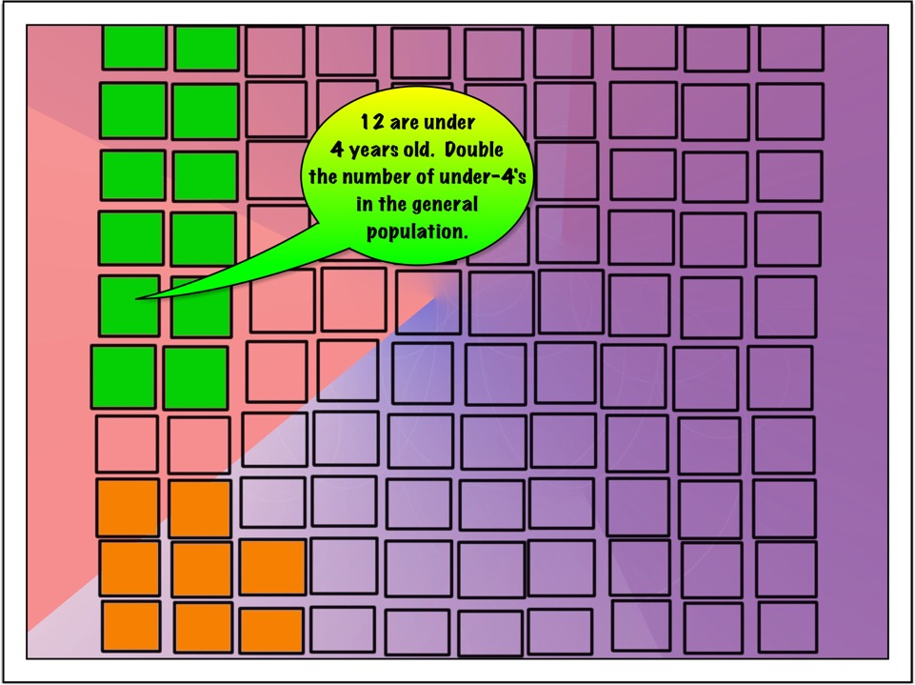
Notes:
12 are under 4. This is twice the proportion of under-4's as in the general population.

Slide 5
Notes:
2 are in jail. This number is probably a bit on the low side.

Slide 6
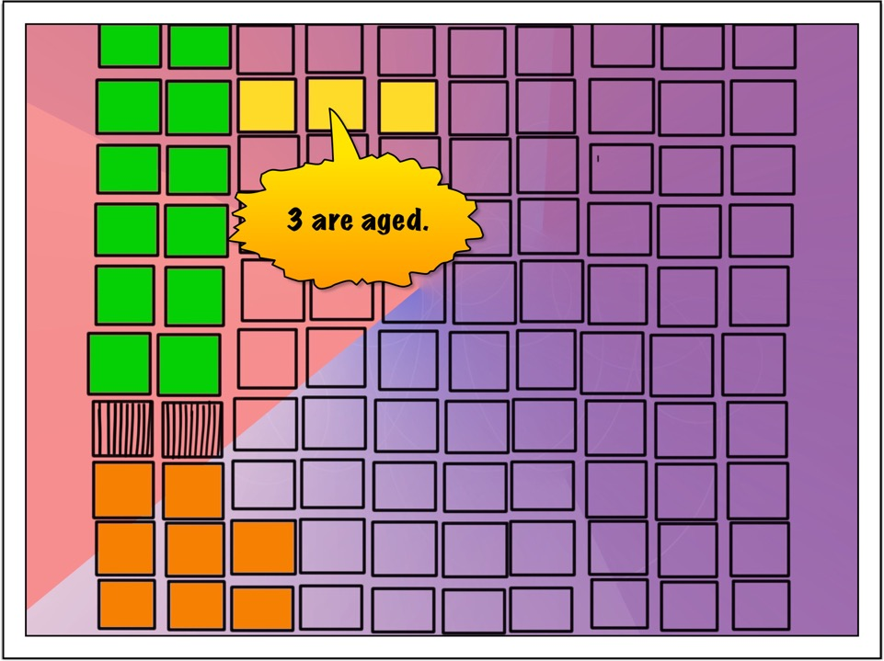
Notes:
There are far fewer people over 60 in the Aboriginal population than in the non-Aboriginal population – between 4 to 10 times less.

Slide 7
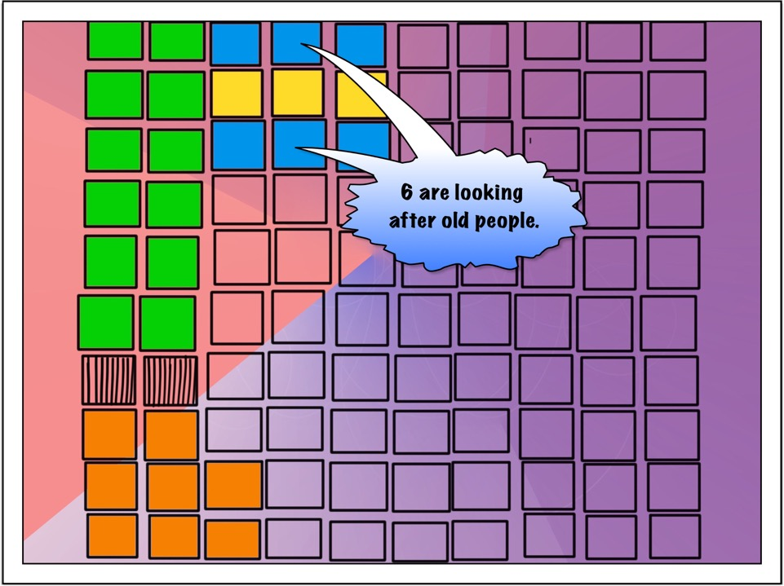
Notes:
Aged care services are very basic in many remote communities and older people mostly live with family. It is quite likely that aged people with a pension are providing for other members of their families who have no income.

Slide 8
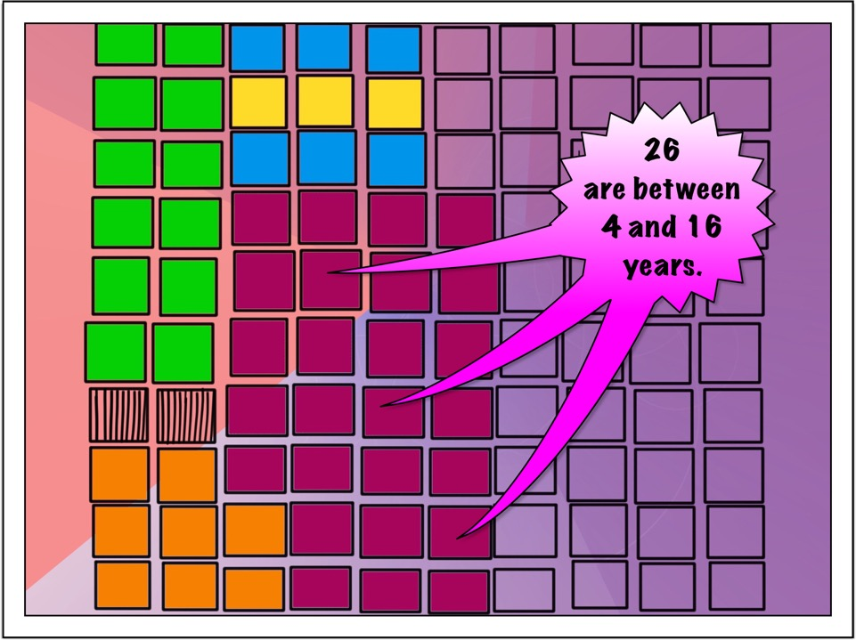
Notes:
This is about double the number of young Aboriginal people as in the general population. Young people in this age group used to look after the younger kids, but school has put a stop to that.

Slide 9
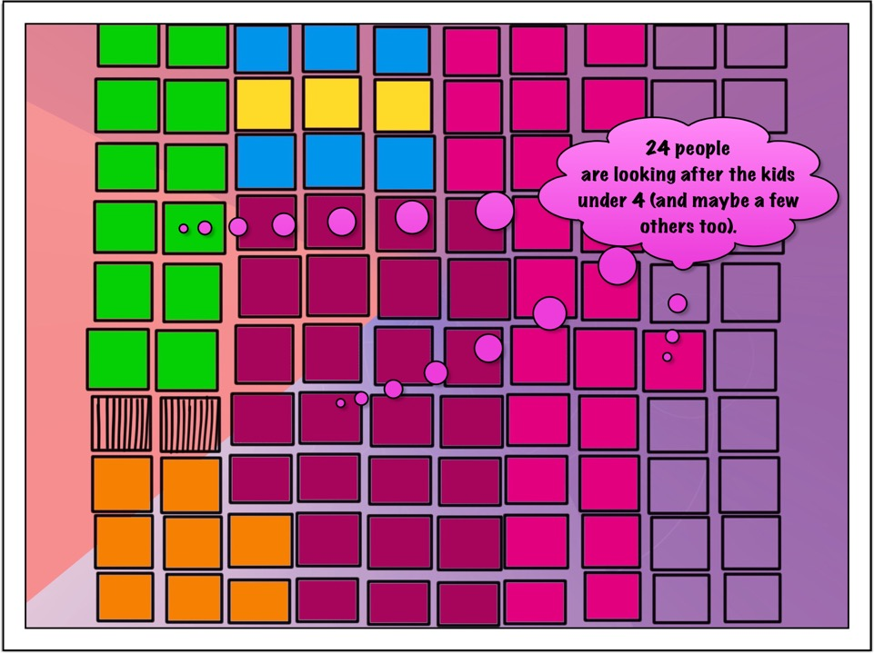
Notes:
24 people - an average of 2 adults per child - are looking after the kids under 4, and probably others as well.

Slide 10
Notes:
Disabled people, like old people, generally live with family. If they are lucky enough to get any sort of disability support payment, their income is looking after other family as well.

Slide 11
Notes:
Who knows? Maybe these 6 have jobs.

Slide 12
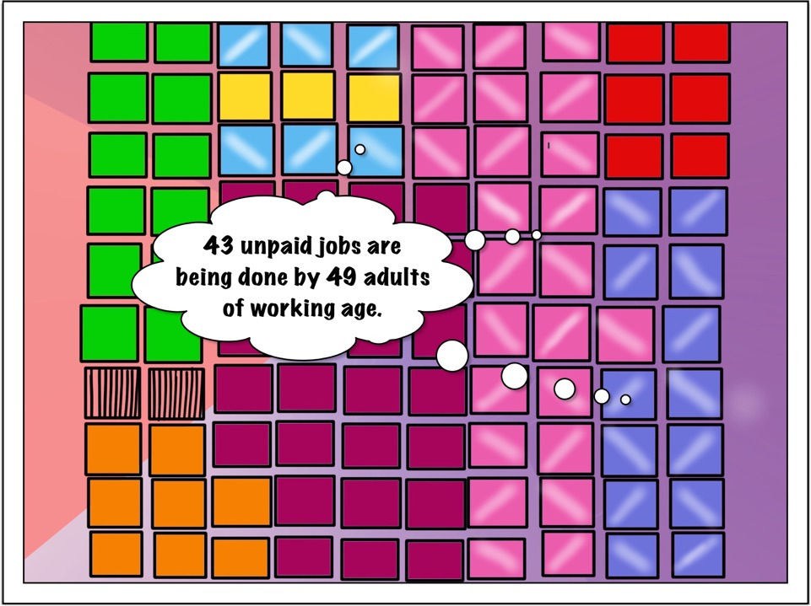
Notes:
43 unpaid jobs are being done by 49 adults of working age, and that is work that is being done within the family. This is a lot of unpaid work that is not counted as labor force participation.

Slide 13
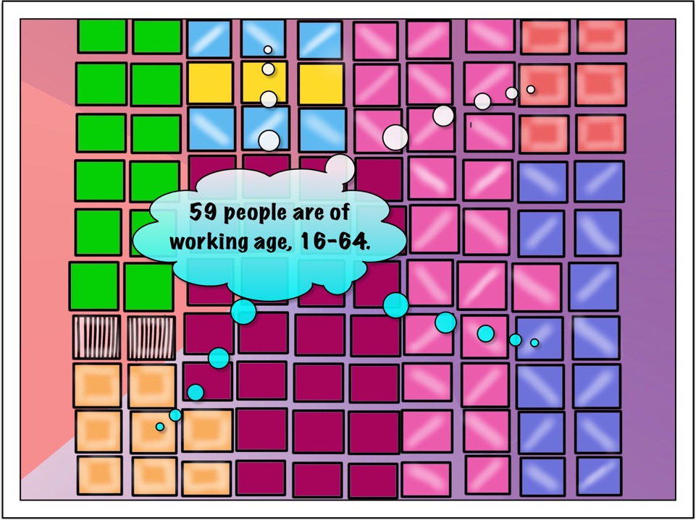
Notes:
Including those with disabilities and people in jail, that makes 59 people out of 100 people that are of working age in remote Aboriginal communities.

Slide 14
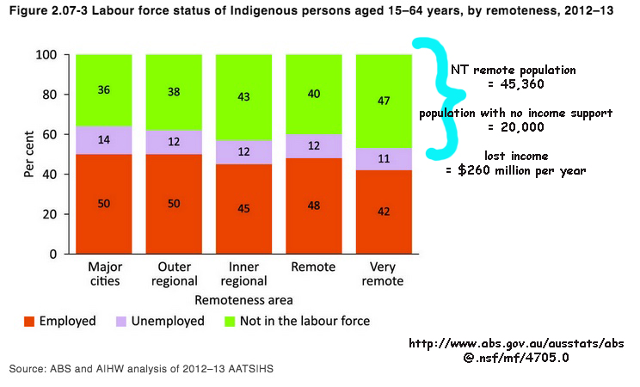
Notes:
These stats apply to people in that working age (16-64) group. There are a couple of things that are noteworthy about these stats. One is that the proportion of Aboriginal people that are on unemployment benefits (mauve) is actually lower than in major cities. The other is the very high proportion of Aboriginal people in remote communities that receive zero income (green). They are neither employed, nor on any form of unemployment benefit. This explodes the myth that people out bush are sitting around on the dole. Family look after them far more reliably than remote and punitive government systems, though their inability to access or stay on unemployment benefits further impoverishes their families and communities. The lost income calculation on this graphic is based on the lowest possible Centrelink benefit payable. This situation is probably worse now – these figures are based on ABS stats from 2012-13. This year, a remote community health service calculated that $600,000 worth of income was lost over the last year – in a community of around 300 people. In another larger community (about 700 people) it was more than 2 million dollars. This is why reliable connectivity free of charge is so crucial in remote Aboriginal communities. There is literally no other way for people who live in these communities to access the most basic of services and entitlements. Systemic poverty makes it both impossible and inequitable to expect people to pay for connectivity that is free in the rest of Australia. One public servant’s annual salary would be more than enough to pay for content filtered wifi hotspots in every remote community our region of the NT. Any takers? Nigel?

Slide 15
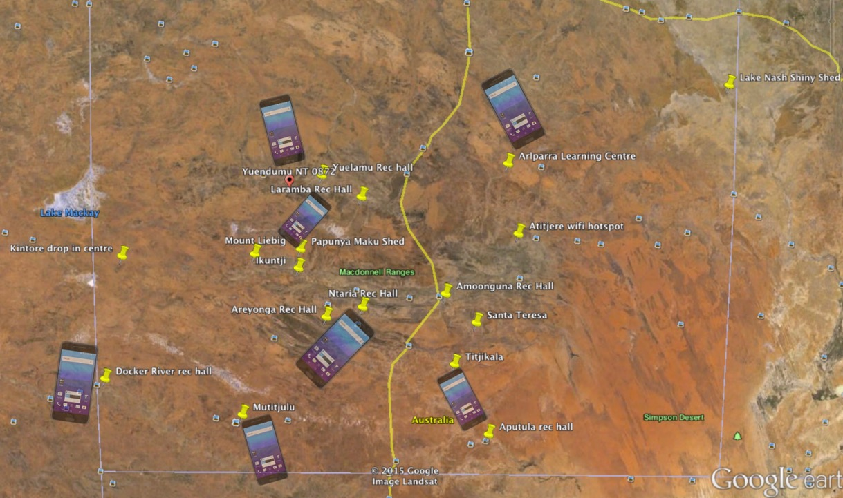
Notes:
A lot of people have access to mobile phones, even if they don’t own one. They are the device of choice because they are relatively cheap, replaceable and available at the local shop. Even in communities without mobile connectivity, mobile phones are the device of choice because they can be used to access websites, send messages and surf the net at the local wifi hotspot, the yellow pins on this map. Mobile phones have a hard life, as they are often shared, relied upon by multiple users, and are very highly valued. The devices are so highly valued because they are sometimes the only way for people to access services like internet banking, stay in touch with family, etc. Because of the heavy usage and multiple users, phone credit doesn’t go far. Prepaid credit, which the majority of Aboriginal people use out bush and in town, is the most expensive way to purchase data, and it is very difficult to navigate prepaid options for recharging your credit, or to work out how much it is actually costing you.

Slide 16
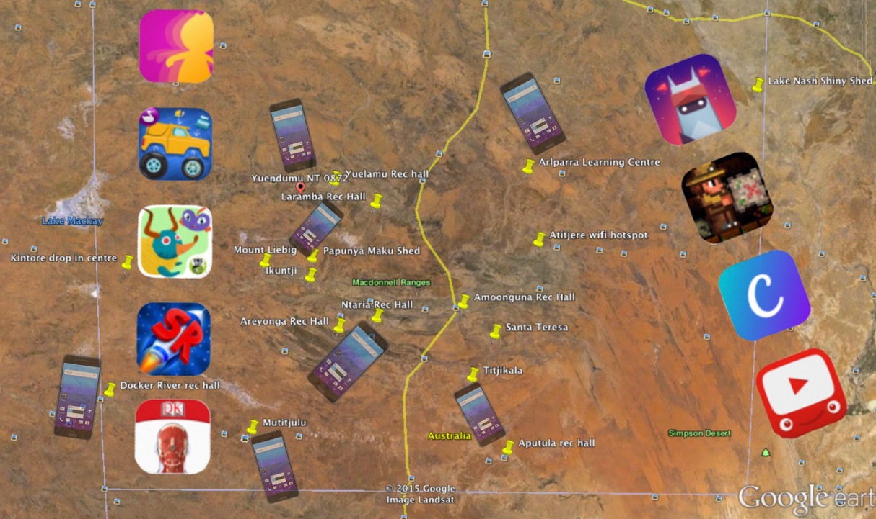
Notes:
Favourite apps to download are often games for the kids.

Slide 17
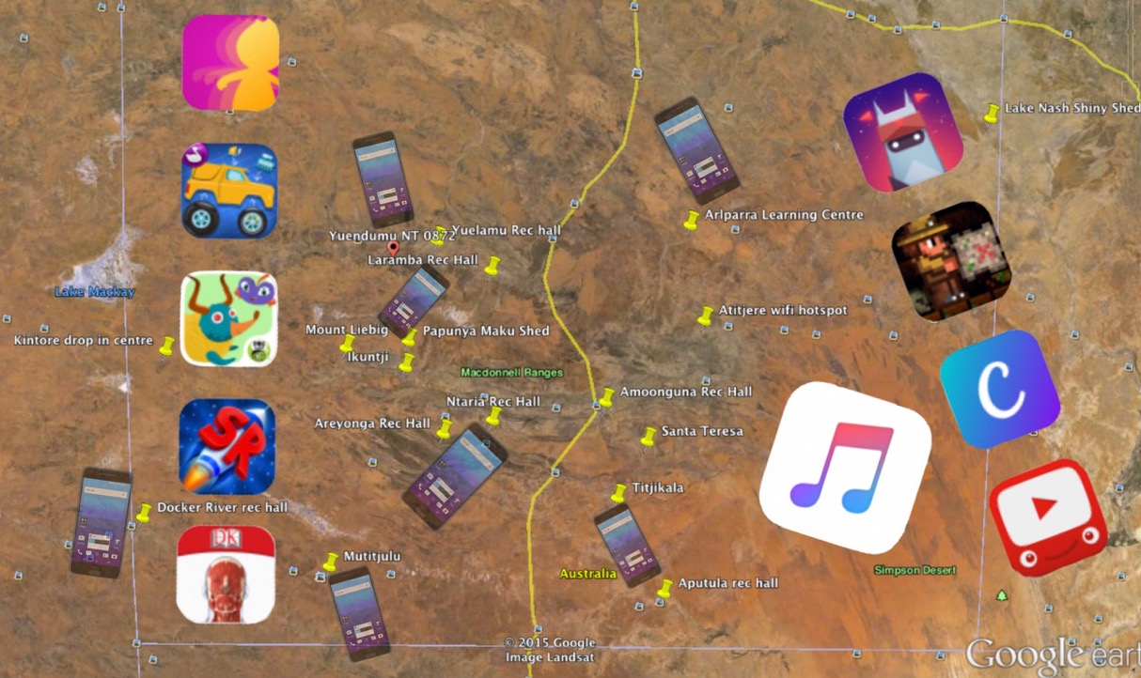
Notes:
People love to download music.

Slide 18
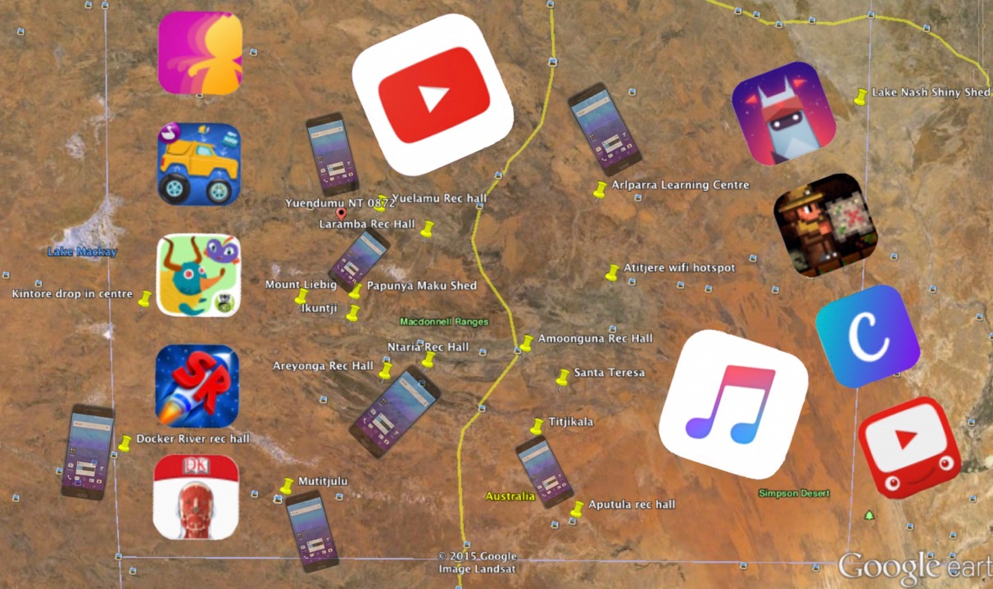
Notes:
And watch Youtube clips. A great way to find out how to cook a rainbow cake or make a pizza, fix a car engine, watch your favourite bands perform, and research funny cat videos.

Slide 19
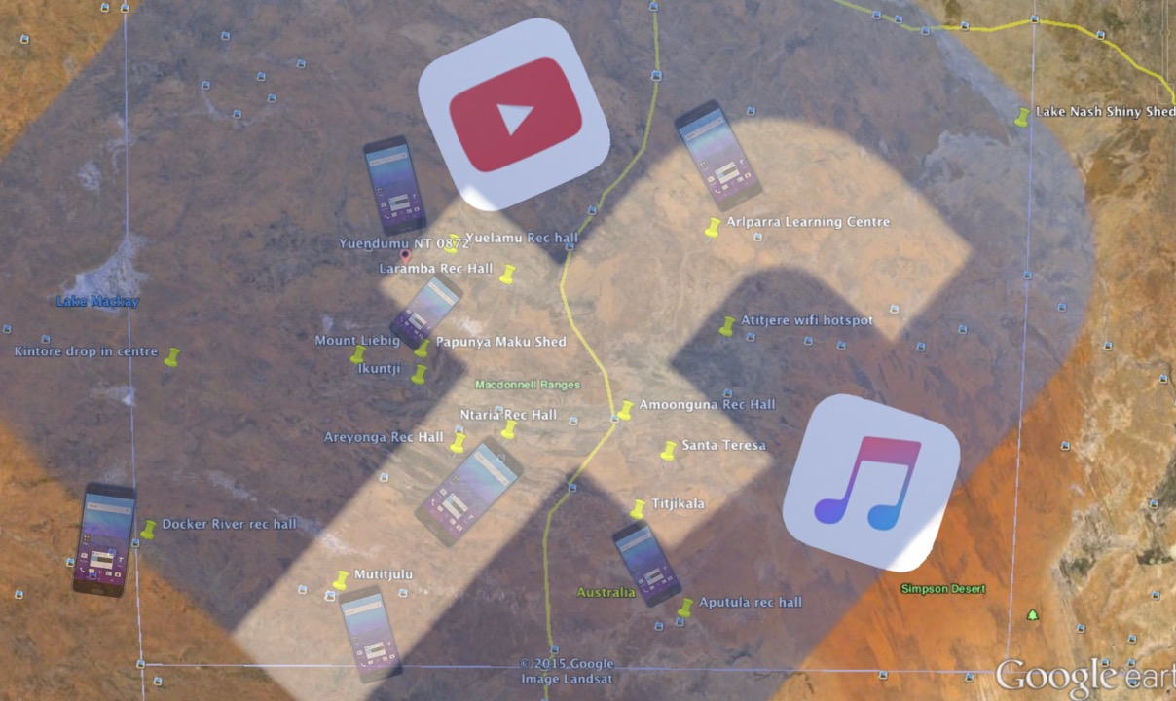
Notes:
And social media is HUGE. Staying in touch with family is paramount, they are the primary and most reliable source of support, and the consequences of social exclusion can be very dire indeed.

Slide 20
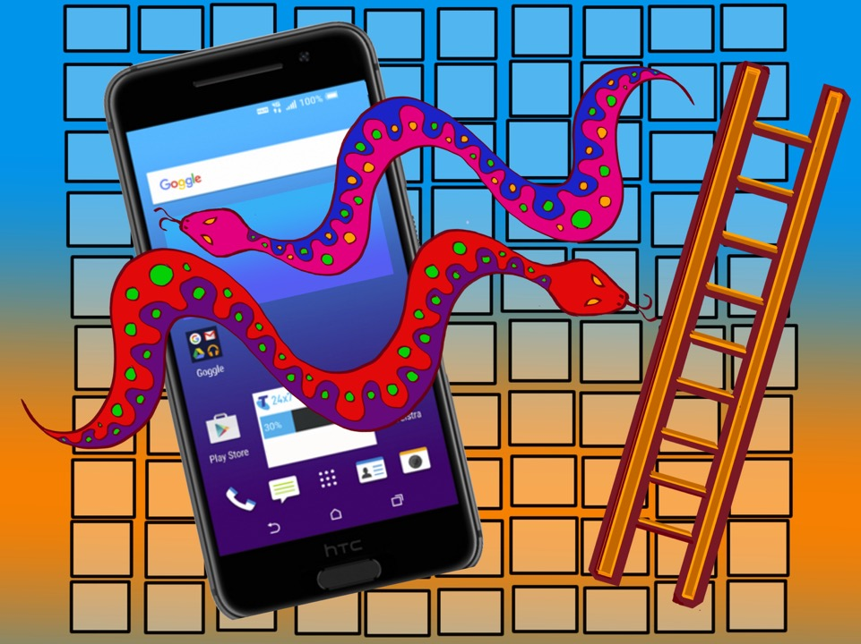
Notes:
And now it’s time to play a game of mobile phone snakes and ladders, a cautionary tale about social exclusion and disruption that involves lot of snakes and hardly any ladders.

Slide 21
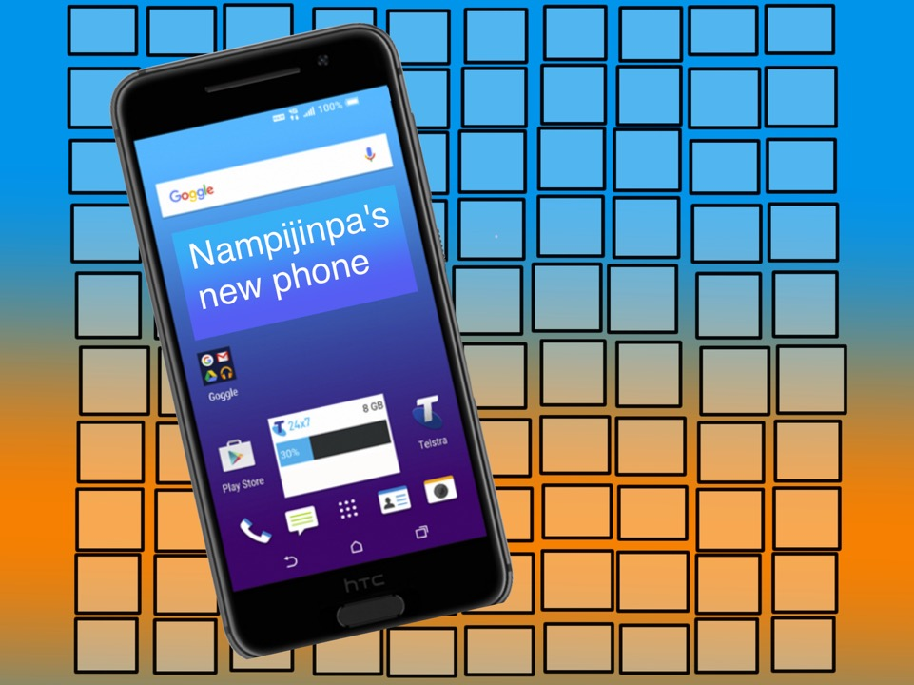
Notes:
Nampijinpa buys a new phone! She’s got $30 of prepaid phone credit.

Slide 22
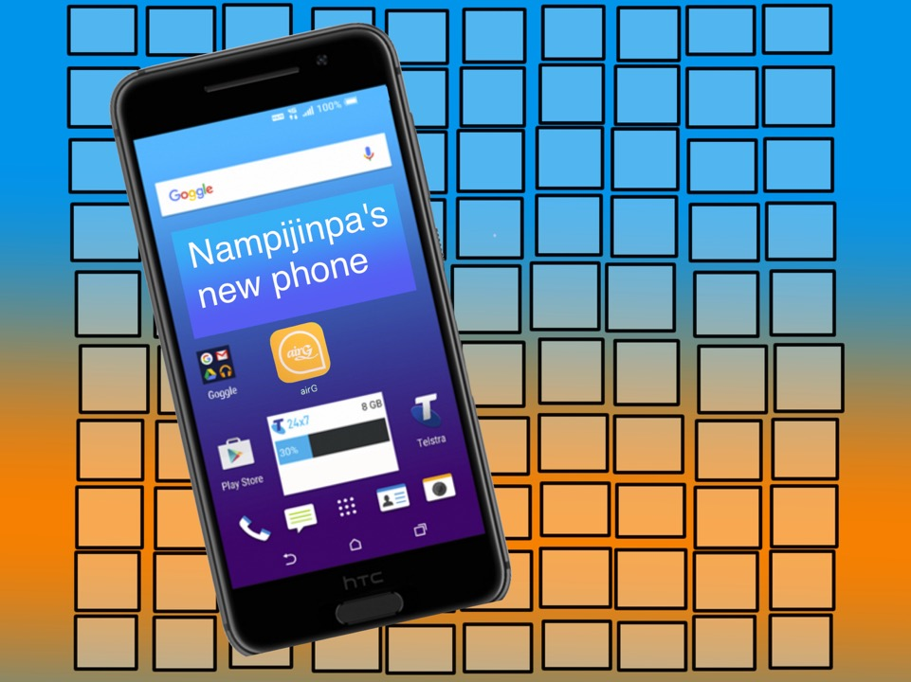
Notes:
Nampijinpa downloads airG. She sends some messages to friends and family, who are all on AirG. She wants to send some little pictures with her messages, so she clicks on the link to sign up for AirG VIP.

Slide 23
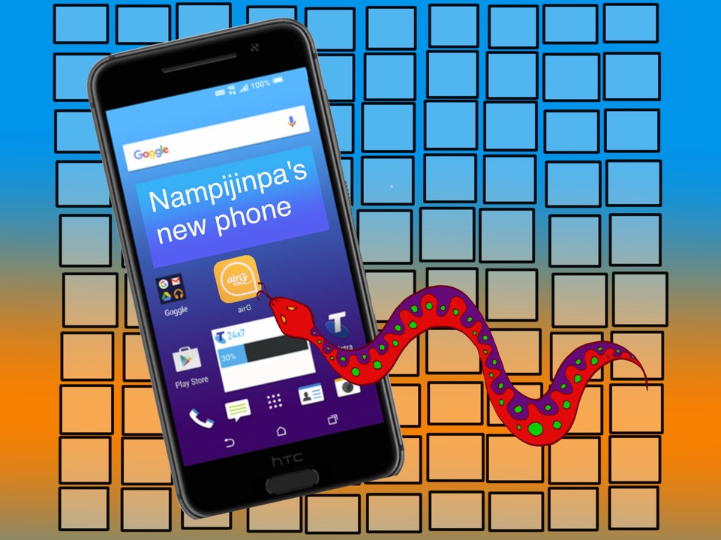
Notes:
What she doesn’t realise is that AirG VIP is costing her $1 a day from her phone credit. She doesn’t read English very well.

Slide 24
Notes:
Nampijinpa’s three young cousins borrow her phone.

Slide 25
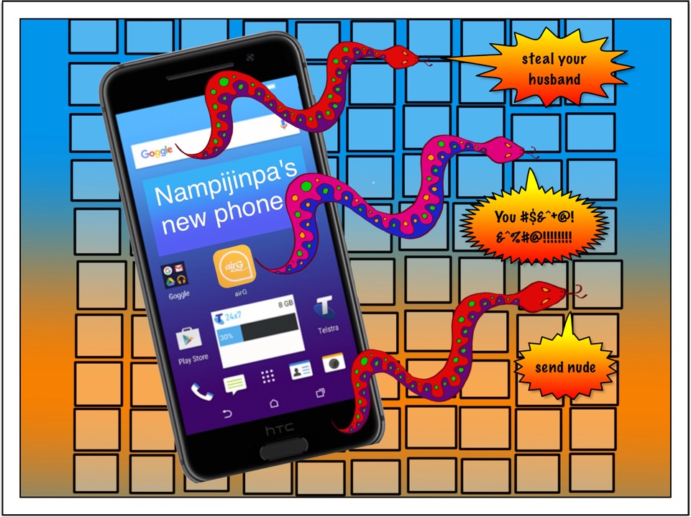
Notes:
They send some cheeky messages to people on Nampijinpa’s contacts list. They use up all of Nampijinpa’s phone credit playing on the internet. Nampijinpa has to go down to the community computer room so she can do her Centrelink reporting.

Slide 26
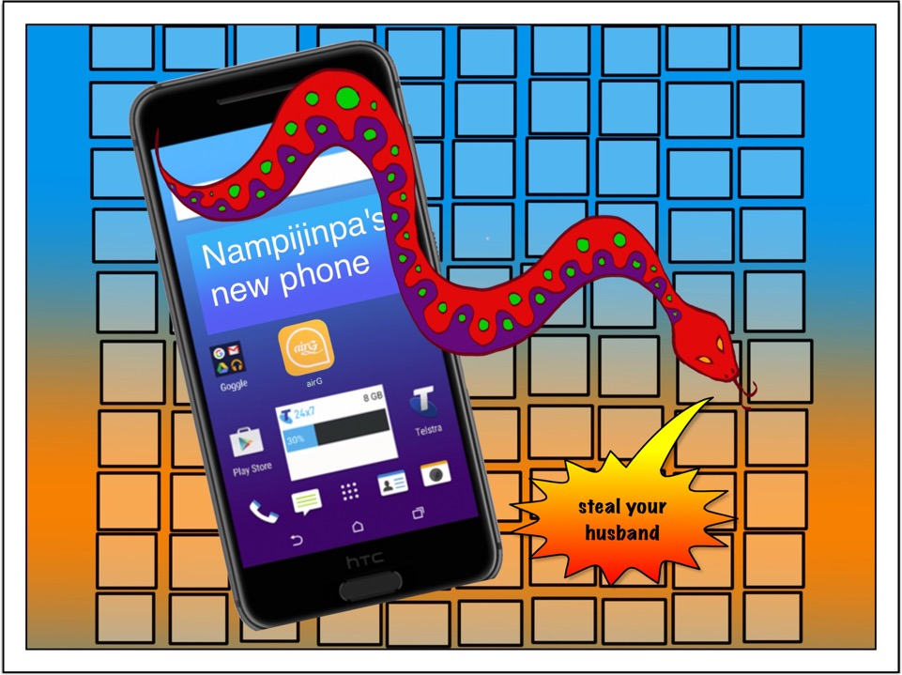
Notes:
Next time Nampijinpa goes to the Store, Nungala tries to hit her. After the yelling has died down a bit, Nakamarra shows her the message on Nungala’s phone that says that Nampijinpa is going to steal her husband. This is extremely offensive, as Nungala’s husband is a ”wrong way” realtionship for Nampijinpa. Nampijinpa doesn’t have a partner right now, so Nungala is really jealous. Nampijinpa, Nungala and Nakamarra work out that those young cousins must have been the ones that sent that message, because they are the only ones that had that phone before it ran out of credit. The cheeky cousins are lying low and enjoying all the trouble.

Slide 27
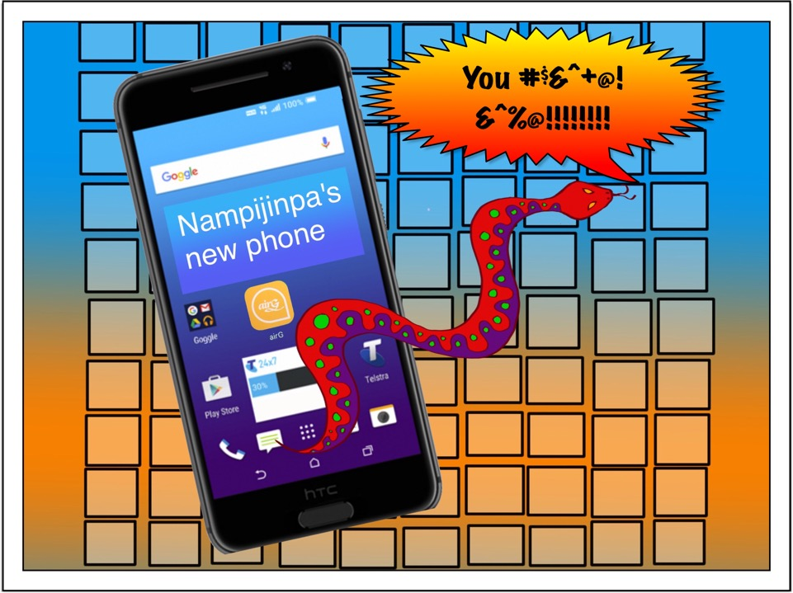
Notes:
Family come from other communities for Sports Weekend. A family fight breaks out during a football game, when all the families are together in the one place. Night Patrol come and break up the fight. Japaljarri from the next community shows the Night Patroller the swearing on AirG, and blames Nampijinpa for causing the fight. The Night Patroller has heard about the jealousing caused by Nampijinpa’s cheeky cousins, and asks the youth worker to show Japaljarri and his family how easy it is to impersonate someone if you have their phone. Japaljarri is still suspicious of Nampijinpa, but agrees that it might not have been her that was swearing at him and his family.

Slide 28
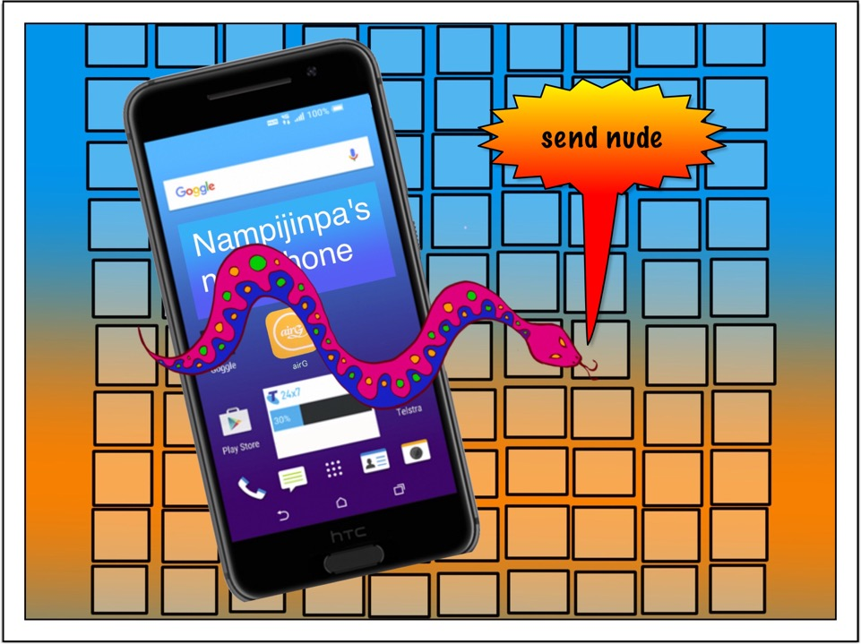
Notes:
Those cheeky cousins also sent a message to Japangardi asking for a nude picture. Japangardi is married to Nampijinpa’s sister, so this causes a jealous fight between Japangardi and his wife, and another jealous fight between the two Nampijinpa’s. Jealousing is a very specific and quite complex form of conflict between Aboriginal people and groups. Briefly, the kinship system defines one’s obligations and rights within and between families. Relationships are constantly in the process of being negotiated and re-negotiated, as local circumstances and even location can change the way those rights and responsibilities operate – some people call this negotiating process, which can be quite robust, humbug. Jealousing can be loosely glossed as a sense of aggrieved entitlement, and can be applied to objects and access to resources as well as to interpersonal and family relationships.

Slide 29
Notes:
Conflicts created and exacerbated by social media are nothing new, but in a situation where relationships within and between people families can mean the difference as to to whether you and your kids go hungry or not, whether you end up being a perpetrator or a victim of violence (probably both), and whether you are safe, the consequences of digital conflict are particularly toxic.

Slide 30
Notes:
If you are in this group of people with no income

Slide 31
Notes:
And you are depending on family and relationships in order to get the most basic of necessities,

Slide 32
Notes:
You can’t afford to have those relationships jeopardised in any way. As you can see from Nampijinpa’s stories, digital conflict has very powerful consequences.

Slide 33
Some other mobile phone hazards:
These are all stories from people out bush have told me about mobile phones.
When you buy your new phone, it has to be activated. You have to have an email address and ID to activate the phone. You don’t have an email address, so you have to find someone who does who is willing to help you get the phone activated. The local community store can’t help you.
When someone steals your simcard and you can’t ring your parole officer. They can’t ring you either. Warrant gets issued. This makes you nervous about contacting Centrelink or any other government service because now you have a warrant.
Someone gets jealous and smashes your phone. Better than smashing you, but now you can’t contact family, so you have to look for a phone you can borrow.
Mobile phone goes flat on hold for Centrelink. Get breached by Centrelink and lose your payments.
Have to use the powerpoint at the basketball court or wait until the computer room is open to recharge your phone because no-one at home has got any money for power cards. The Council won’t let you use their phone or power points.
All your daily data allowance at the wifi hotspot gets used up by the phone updating itself, so no data left to do internet banking or Centrelink reporting.
All your daily data at the wifi hotspot gets used up with the 20 apps your kids have open on the phone refreshing.
www.caylus.org.au computer rooms page
Notes:
If someone steals your sim card and you can’t ring your parole officer.
If someone gets jealous and smashes your phone. Mobile phone goes flat waiting for Centrelink. Using the powerpoint at the basketball court to recharge your phone because no-one at home has money for power cards. Council office won’t let you use their phone or power points.

