Slide 1
Methamphetamine Use in Australia: current patterns and trends, and their implications for treatment and intervention. methamphetamine
Ann Roche
Professor and Director
National Centre for Education and Training on Addiction (NCETA)
www.nceta.flinders.edu.au
Ice and Central Australia: From Research to Practice
Alice Springs, 4 November 2015

Slide 2
Acknowledgments
NCETA Team:
Dr Alice McEntee,
Dr Ken Pidd,
Dr Jane Fischer,
Victoria Kostadinov
Australian Government Department of Health

Slide 3
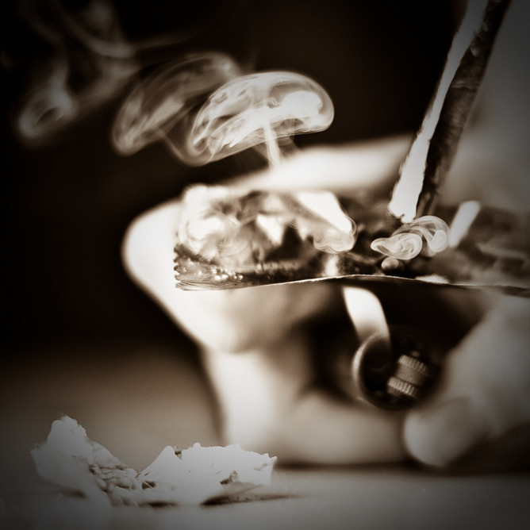
Current Context
Increasing concern in Australia about methamphetamine use, often framed as ‘ice’ use
Strong media interest
‘An Epidemic of Negative Headlines’
Pressure on health and community services to respond appropriately
Family impact and social disruption

Slide 4
What’s the current situation?
This presentation provides an overview of the current data to inform our understanding of patterns, problems and potential responses.
Data will provide only part of the insight and understanding required. Best available data is limited.
The community, families and users, and service providers need to complement the available data with first hand knowledge and experience.

Slide 5
Key Questions and Considerations
What is Methamphetamine?
What is ‘Ice’?
What has changed?
What is the concern?
Who is most likely to experience problems?
Whtas the situation in rural and remote Australia?
What are the best evidence-based intervention options?

Slide 6
Pleasure
Pain
Purpose

Slide 7
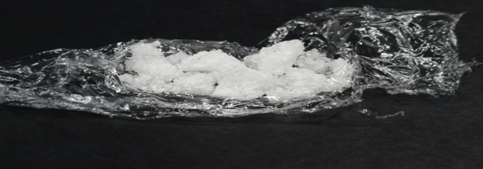
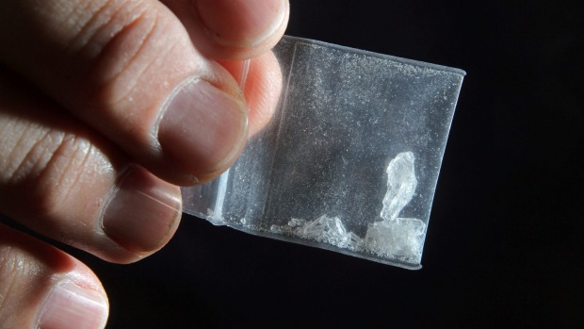
Methamphetamine belongs to the ‘stimulant’ class of drugs, which also includes amphetamine, ecstasy, and cocaine.
They stimulate the brain and central nervous system; can result in a range of physiological and psychological changes including:
a) increased alertness/euphoria/energy/enhanced mood …..
b) anxiety/panic/agitation/hallucinations…aggression/violence.
3 main forms of methamphetamine:
powder (speed)
base
crystal (ice)

Slide 8
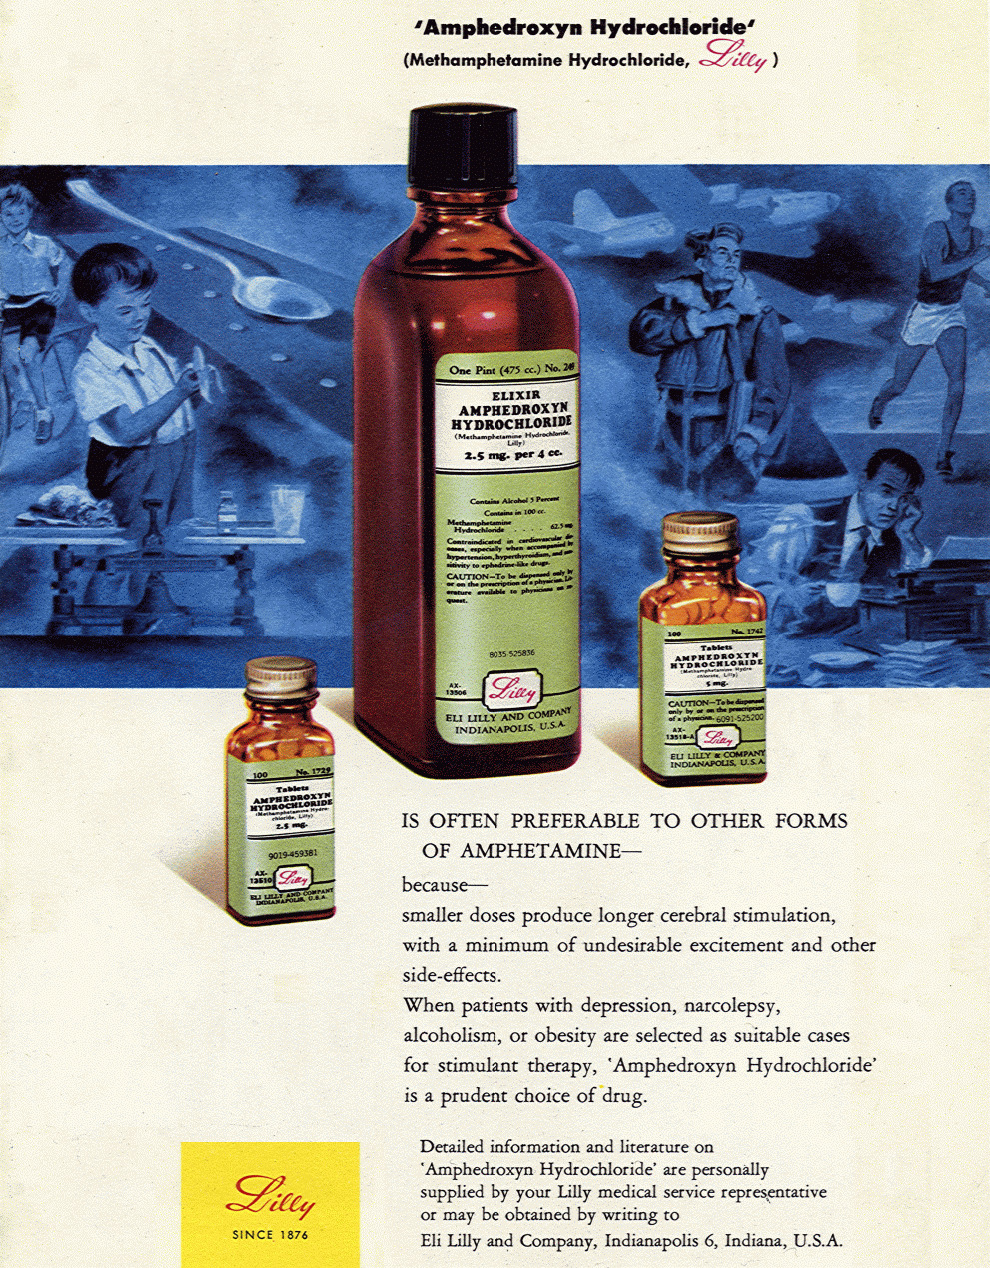
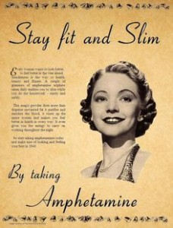
Meth/amphetamine & performance
Notes:
Mother's Little Helper - The History of Amphetamine and Anti-Depressant Use in America
By Tony B. Rich and Meg Jordan, PhD, RNPrintable PDF Version > From 1935 when Benzadrine Sulfate first appeared to entice doctors to prescribe amphetamines to housebound women tired of their daily drudgery, through chemical manipulation and rebranding into the fastest selling drugs to children and young adults, the history, evolution and morphology of amphetamine usage in America is eye-opening
During the 1950s and 1960s, amphetamine and methamphetamine were viewed as 'utilitarian drugs' that working- and upper middle-class individuals would use to increase their energy, meet performance and endurance goals, and as a popular weight loss and antidepressant medication.

Slide 9
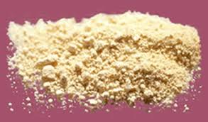
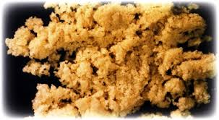
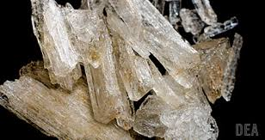
Types of Methamphetamine
Notes:
Bottom Left – Base Top– Hydrochloride salts/powder (Speed) Bottom Right – Crystalline (Crystal Meth / Ice)

Slide 10
Of particular concern is the crystalline form of methamphetamine,
known as ‘ice’.
Ice (also known as crystal meth, meth, crystal, shabu, batu, d-meth, glass, or shard):
most potent form of methamphetamine,
usually smoked or injected.

Slide 11
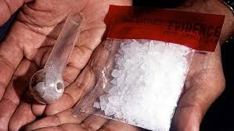
Crystalline
Also known as Crystal Meth/Ice
Purer form than Salts/Powder
Highly Addictive
Highly Corrosive
Generally Smoked
High risk of volatile off gassing when produced
The most talked about form in 2015
Now the most commonly used form of Meth
Notes:
Most talked about in the media in 2015

Slide 12
What’s Changed?
Price
Purity
Form
Mode of administration
Frequency of Use

Slide 13
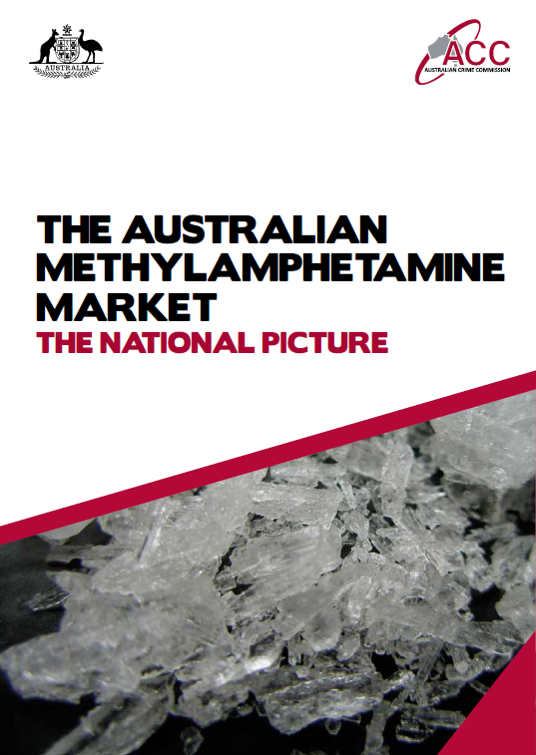
Scott et al., 2014
Reported:
Increase in purity
Decline in purity-adjusted price per gram
Extreme purity variation

Slide 15
Patterns of use and Manifestation of Problems
Multiple sources….anecdote, media, observation, service providers, law enforcement…
National Drug Strategy Household Survey (NDSHS)
2. National Minimum Data Set ( AOD Treatment Specialists)
Hospital Morbidity Data
Other (IDRS, EDRS, ED, specific targeted studies)

Slide 16
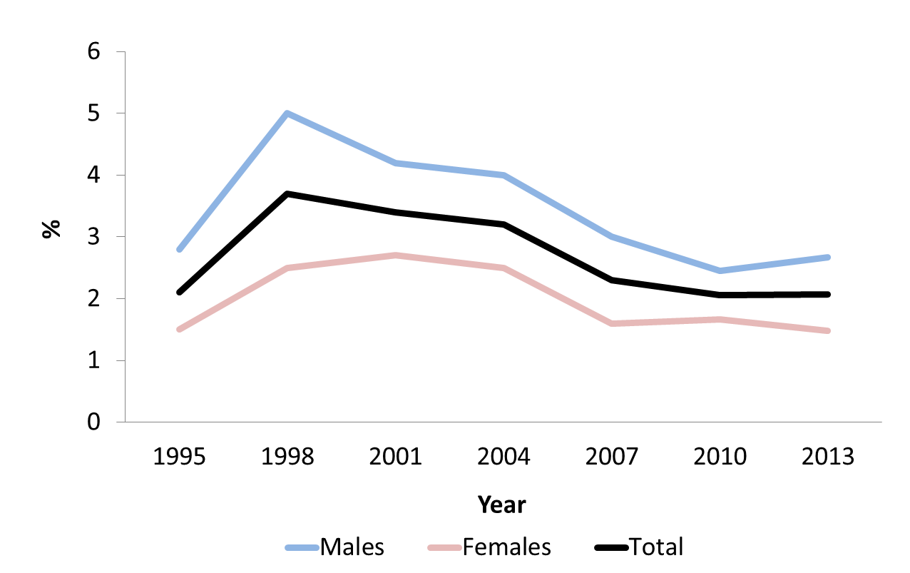
Recent methamphetamine use in Australia, 1995-2013
Source: Australian Institute of Health and Welfare (AIHW). 2013 National Drug Strategy Household Survey
Notes:
Figure 2: Proportion of Australians (14+ years) Who Have Used Methamphetamine in the Past 12 Months

Slide 17
Prevalence of recent methamphetamine use stable at approximately 2% nationally since 2007.
Prevalence varies by geographic location.
Recent meth use in major cities significantly decreased from 2.5% to 2.1% (2007 & 2013).
In contrast, recent meth use in remote locations increased significantly from 1.9% to 2.6% (2007 to 2013).
Remote locations had significantly higher prevalence of recent methamphetamine use compared to use in major cities and inner regional locations.

Slide 18
Methamphetamine use in the Australian population, 2013
Frequency of Methamphetamine Use
Source: Australian Institute of Health and Welfare (AIHW). 2013 National Drug Strategy Household Survey (NCETA secondary analysis, 2015).
Notes:
Figure 1: Proportion of Australians (14+ years) Who Have Used Methamphetamine

Slide 19
Frequency of methamphetamine use, 2007-2013
Notes:
Source: Australian Institute of Health and Welfare (AIHW). 2007, 2010, 2013 National Drug Strategy Household Survey (NCETA secondary analysis, 2015).

Slide 20
Main form of meth used in last 12 mnths, 2007-2013
Source: Australian Institute of Health and Welfare (AIHW). 2007, 2010, 2013 National Drug Strategy Household Survey (NCETA secondary analysis, 2015).
* Estimate may be unreliable due to small sample size

Slide 21
Main method of meth use, 2007-2013
Source: Australian Institute of Health and Welfare (AIHW). 2007, 2010, 2013 National Drug Strategy Household Survey (NCETA secondary analysis, 2015).
* Estimate may be unreliable due to small sample size
Notes:
Figure 6: Main Mode of Methamphetamine Administration by Australians Who Have Used Methamphetamine in the Past 12 Months

Slide 22
ICE
For crystal methamphetamine, nationally recent use increased significantly between 2007 and 2013 (1.2% vs 1.4%).
In 2013, prevalence of recent use of Ice was highest in remote locations (2.0%*). Significant increase in crystal methamphetamine use between 2007 & 2013 (0.8% vs 2.0%).
The prevalence of crystal methamphetamine use in remote locations was significantly higher than prevalence in major cities, inner regional locations, and Australia overall.

Slide 23
Mean age of methamphetamine users, 2007-20013
 | 2007 | 2010 | 2013 | Trend
Ice Users | 29.5 years | 28.9 years | 28.8 years* | ä
Other Methamphetamine Users | 28.6 years | 30.0 years | 30.9 years* | ã
All Methamphetamine Users | 28.9 years | 29.6 years | 30.1 years* | ã
Source: Australian Institute of Health and Welfare (AIHW). 2007, 2010, 2013 National Drug Strategy Household Survey (NCETA secondary analysis, 2015).
Notes:
Table 1: Mean age of methamphetamine users by form of methamphetamine used, 2007-2013

Slide 24
% methamphetamine users (last 12 months) by employment status
2.1% Total Population
Data source: 2013 National Drug Strategy Household Survey
Notes:
Employment status: Whether an individual is currently: a) employed; b) unemployed; or c) not in the labour force.
Employed: Self-employed, working for salary or wages
Unemployed: Not currently working and actively seeking employment.
Not in the labour force: Engaged in home duties, volunteer/charity work, student, retiree/pensioner, other.
Weighted data age≥14

Slide 25
Number of methamphetamine users (last 12 months) by employment status
Data source: 2013 National Drug Strategy Household Survey
Notes:
Employment status: Whether an individual is currently: a) employed; b) unemployed; or c) not in the labour force.
Employed: Self-employed, working for salary or wages
Unemployed: Not currently working and actively seeking employment.
Not in the labour force: Engaged in home duties, volunteer/charity work, student, retiree/pensioner, other.
Weighted data age≥14

Slide 26
Prevalence by occupation
Data source: 2013 National Drug Strategy Household Survey
Notes:
Weighted data age≥14 & employment status = employed for wages or salary or self employed

Slide 27
Prevalence by industry
Other industries <2.0%
Data source: 2013 National Drug Strategy Household Survey
Notes:
Weighted data age≥14 & employment status = employed for wages or salary or self employed

Slide 28
Workplace harms
 | Meth | Other illicit | Sig diff
Absenteeism due to injury* | 16.9% | 10.3% | p<.01
Absenteeism due to illness* | 42.3% | 39.5% | ns
Absenteeism due to drug use* | 7.3% | 1.3% | p<.01
Absenteeism due to alcohol use* | 12.5% | 6.4% | p<.01
Usually use at work | 9.7% | 3.8% | p<.01
Worked under influence# | 31.6% | 6.0% | p<.01
* at least 1 day off in past 3 months
# at least once in past 12 months
Data source: 2013 National Drug Strategy Household Survey

Slide 29
High risk workforce groups
Workers aged 20-29
Males
Trades/blue collar
Industry
Wholesale
Construction
Mining
Manufacturing
Hospitality

Slide 30
Less frequent (yearly) users of methamphetamine, including ice users, tend to be:
employed,
heterosexual,
male,
low levels of psychological distress.
Frequent (weekly/monthly) methamphetamine users, including ice users, tend to:
comprise more females,
be less likely to be married
fewer heterosexual.
Frequent users are also more likely to be:
unemployed,
psychologically distressed,
engage in various risk taking activities
Likely to be a non-treatment seeking population

Slide 31
AOD Treatment Specialist Services
Report growing episodes of care for methamphetamine
In 2009/10, <1% of episodes of AOD specialist treatment were for meth (n=1,240)
In 2012/13, >3% of episodes of AOD specialist treatment were for meth (n=4,043)

Slide 32
Treatment for methamphetamine¹ as the principal drug of concern by geographic location and jurisdiction 2006/07, 2009/10 and 2012/13 (NMD)
 | 2006/07 |  | 2009/10 |  | 2012/13 |  | Sig testing
 | n | % | n | % | n | % | Z (p-value) one tailed
Australia | 17118 | 12.2* | 9930 | 7.1 | 22038 | 14.3* | *16.7 (0.000)
Major cities | 13397 | 13.7* | 7543 | 8.2 | 16256 | 16.2* | *15.6 (0.000)
Inner regional | 2701 | 9.8* | 1765 | 5.8 | 3988 | 12.3* | *9.7 (0.000)
Outer regional/remote /very remote | 1020 | 7.2* | 622 | 3.6 | 1794 | 8.5* | *4.4 (0.000)
NSW | 4748 | 12.8* | 2268 | 6.6 | 4547 | 13.5* | *2.8 (0.006)
VIC | 3422 | 7.5* | 2666 | 5.4 | 6778 | 13.3* | *29.3 (0.000)
QLD | 2469 | 10.1* | 1342 | 5.9 | 3199 | 10.9* | *3.0 (0.001)
WA | 4178 | 25.9* | 2280 | 14.2 | 3963 | 17.9* | *18.2 (0.000)
SA | 1629 | 18.8* | 991 | 11.2 | 2692 | 23.9* | *8.7 (0.000)
TAS | 189 | 12.8* | 87 | 6.0 | 255 | 12.0* | *0.7 (0.236)
ACT | 376 | 8.7* | 211 | 6.2 | 496 | 11.4* | *4.2 (0.000)
NT | 107 | 4.8* | 85 | 2.5 | 158 | 4.7* | *0.2 (0.433)

Slide 33
Methamphetamine treatment: Indigenous status by age, 2012/13
Source: Australian Institute of Health and Welfare (AIHW). 2012/13 Alcohol and Other Drug Treatment Services National Minimum Data Set
(NCETA secondary analysis, 2015).
Notes:
Figure 7a: Treatment Episodes for Methamphetamine as the Principal Drug of Concern by Indigenous status and Age, 2012/13

Slide 34
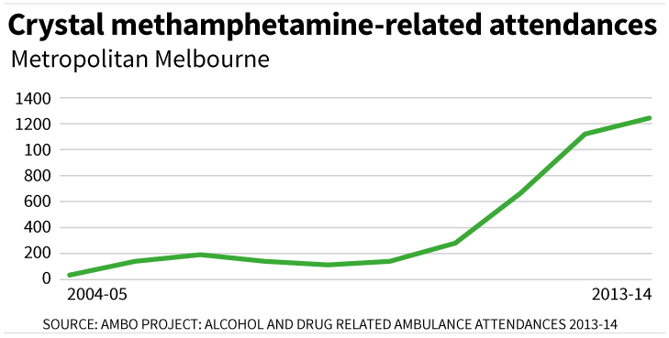

Slide 35
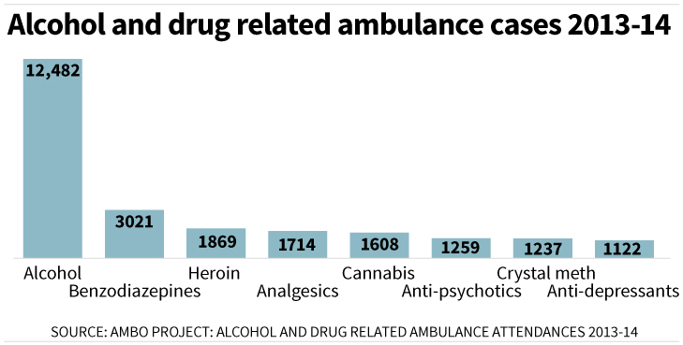

Slide 36
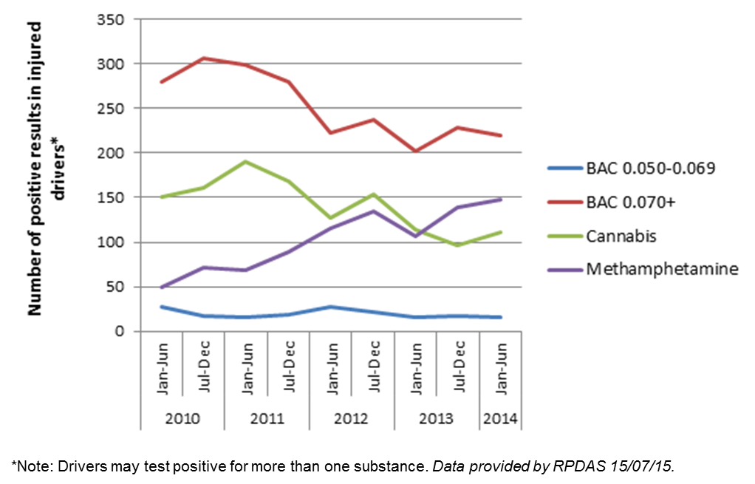

Slide 37
Stimulants as a proportion of all hospital separation for
illicits substances, increased from:
15% 2009/01
27% 2012/13

Slide 38
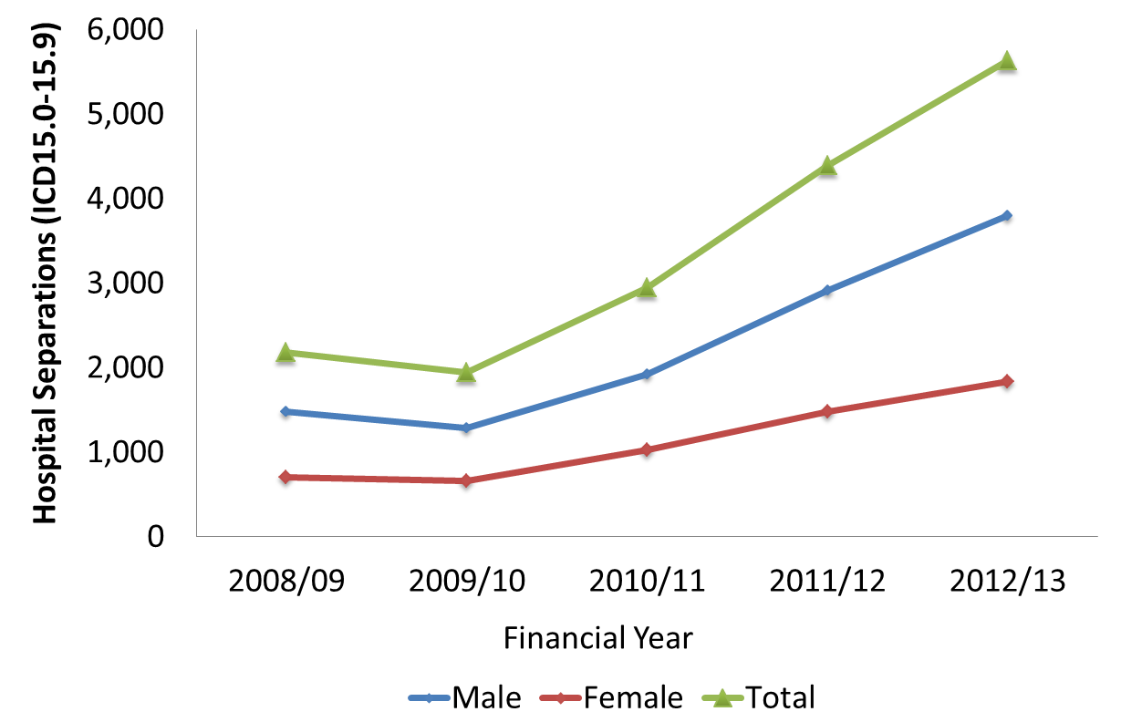
Hospital separations: stimulants, 2008/09-2012/13
158% inc
Source: Australian Institute of Health and Welfare (AIHW). 2008-2013 National Hospital Morbidity Database
(NCETA secondary analysis, 2015).
Notes:
Figure 9: Hospital Separations due to Stimulants Other than Cocaine (ICD F15.0-15.9) (15+ years) by Sex and Year

Slide 39
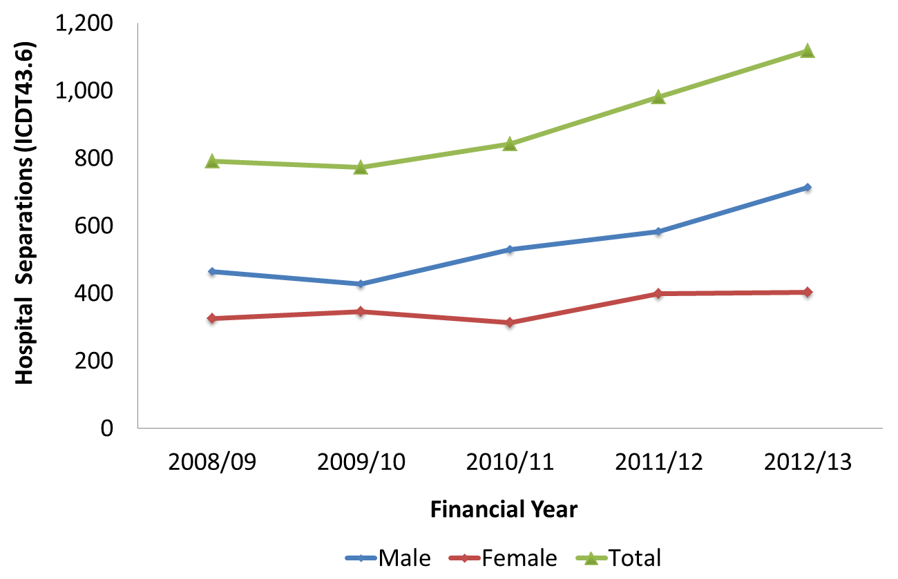
Hospital separations: poisonings due to psychostimulants, 2008/09-2012/13
41% inc
Source: Australian Institute of Health and Welfare (AIHW). 2008-2013 National Hospital Morbidity Database
(NCETA secondary analysis, 2015).
Notes:
Figure 10: Hospital Separations for Poisonings due to Psychostimulants (ICDT43.6) (15+ years) by Sex and Year

Slide 40
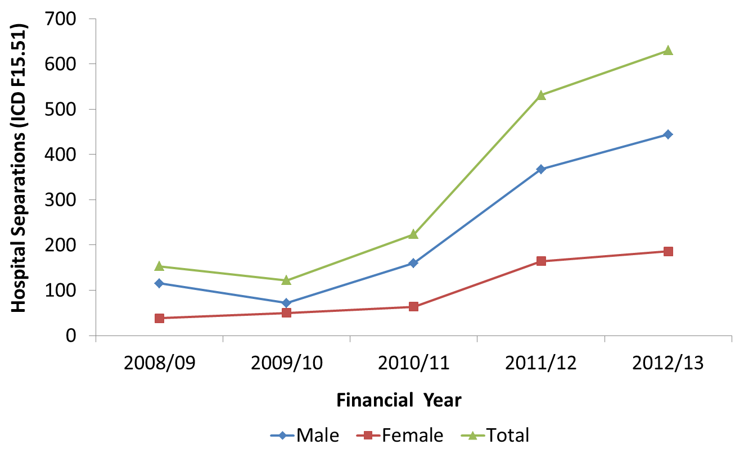
Hospital separations: psychotic disorders due to methamphetamines, 2008/09-2012/13
312% inc
Source: Australian Institute of Health and Welfare (AIHW). 2008-2013 National Hospital Morbidity Database
(NCETA secondary analysis, 2015).
Notes:
Figure 11: Hospital Separations for Psychotic Disorders due to Methamphetamine (ICD15.51) (15+ years) by Sex and Year

Slide 41
Other Considerations
Important not to see either the causes or the responses to meth/ice issues in isolation
Comprehensive/holistic responses needed
Consideration given to concurrent patterns of use:
Alcohol:
- high levels of stimulant use associated with risky drinking and night time economy …
’Wide-awake drunkenness’ (Pennay et al 2014)
Cannabis:
Potential displacement effect, shifting from cannabis to meth to avoid drug detection.

Slide 42
Implications
Clear changes, not in same direction
Problems of severity not prevalence
Greater demand on treatment services
Recognition of impost on services and workers
People with complex needs
Not just a simple drug issue
Targeted interventions needed

Slide 43
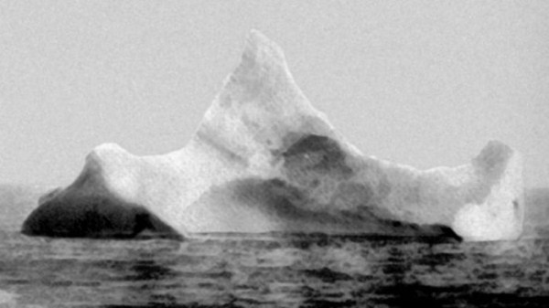
Problems experienced by people with complex needs and concerns.
Tip of the iceberg only.

